Slide 1
Creation of theBoom: the worlds best noise canceling microphones and headsets.
Adithya M.R. Padala – President & CEO – UmeVoice Inc.
www.theBoom.com

Slide 2
Introduction
Umevoice founded in 1995
Focused on voice recognition for trading
Customers:
Typical statement “IBM offer 1 million at 128.99”
Typical sale: $1 M+ for 20 users

Slide 3
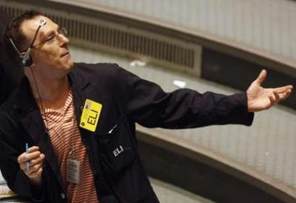
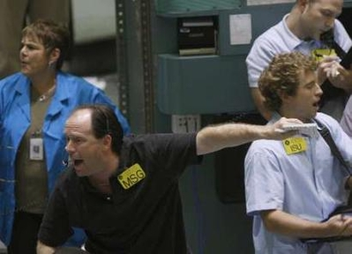
Serendipitous Invention
Trading rooms are noisy places
Exchange floors are much noisier
Babble noise is much tougher than other noise to eliminate
We accidentally invented noise canceling technology!

Slide 4
The World’s Best Noise Canceling Headsets
Notes:
Click the video and it will play full screen. To pause the movie simply click anywhere and to resume playing click again. When the movie is done it will auto rewind and the slide will revert back to it’s initial state.

Slide 5
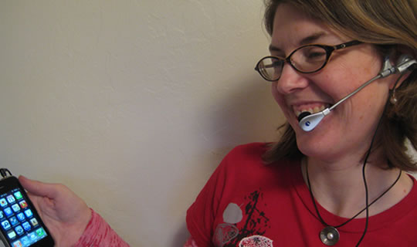
Transforming the Company
Million $ customer - $100 customer
Creation of multiple products from one
Creation of multiple markets: Consumer, Military, Fortune 500 Companies, Racing
The internet

Slide 6
The Design Prototype Build Cycle Our first approach
Industrial Design:
Frog Design
Prototype:
Frog Design
Manufacture:
Non headset company in Taiwan
Market:
Public relations
Improvise (version two):
Repeat cycle

Slide 7
The Design Prototype Build Cycle
Our next approach
Industrial Design:
Freelance local designers
Prototype:
Both in Novato on CNC machine and SLA’s from all over the world
Manufacture:
Subcontract large OEM’s
Begin manufacturing locally specifically for verticals
Market:
Relationships with VAR’s and resellers in verticals
Improvise (new family of products):
Faster more cost effective creation of product lines

Slide 8
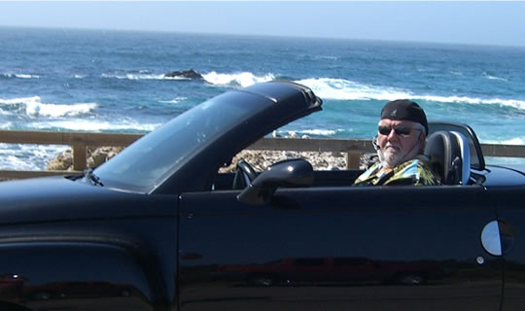
Custom Manufacturing for specific industries
Emergency rooms
Call Centers
Mobile workforce
Aviation
Industrial environments

Slide 9
Bootstrapping Marketing and Sales
The Internet
Trade shows -
Customer driven innovation and product creation
Wall Street, Military, Nascar, Industrial,Voice Recognition

Slide 10
Made in the USA
All customer driven innovation and new product creation
theBoom “E” – custom behind the head headset
UmeCobra – microphone that replaces aviation mics.
Custom solutions for Fortune 500
Wall Street, Military, Nascar, Industrial,Voice Recognition

Slide 11
Abundant local skills
Industrial design
Prototyping (Pro-E engineers)
Design (Machine shops and SLA’s)
Manufacturing (Lots can be done here)
Web development
Search Engine Optimization
Sales and Customer service

Slide 12
Summary
Prototype your idea quickly and find a customer
Focus on verticals where your value proposition is high
Focus on the creation of value to the customer
Plenty of opportunity to design, develop and market your product right here
At the current time there are abundant skills available locally

